Slide 1
Uni
cever
Transforming Event Management through Secure and Verified Organizers
Rajarshi Samaddar, 24400120030,
Prateek Kumar
Danish
Soumayadip Saha 24400120037
Mentor – Mr. Samik Datta

Slide 2
Contents
01 | Overview | 02 | Objective
03 | Project Domain | 04 | Tech Stacks
05 | Proposed System Architecture | 06 | Login/Signup
07 | Create Event | 08 | Manage Event
09 | Certificate Distribution | 10 | Future Scopes
11 | Benefits and Outcomes | 12 | Conclusion

Slide 3
Project Overview
Developing a comprehensive web application to streamline event planning, management, and certificate distribution.
Providing organizers with efficient tools for event-related tasks.
Enhancing the event experience for both organizers and attendees.

Slide 4
Project Objective
Create a secure and user-friendly login/signup system for organizers.
Ensure certificates are unique, secure, and verifiable through individual links.
Verify the legitimacy of organizing entities to enhance event credibility.

Slide 5
Project Domain
Web application development: Merging technology with event management.
Solving challenges faced by event organizers and attendees.
Bridging the gap between efficient technology solutions and event coordination.

Slide 6
Tech Stacks
NEXT. JS
REDUX
TYPE SCRIPT
SUPBASE
MATERIAL UI
AUTH0
VERCEL

Slide 7

Proposed System Architecture
Login/signup
Dashboard
Create event
Manage event

Slide 8
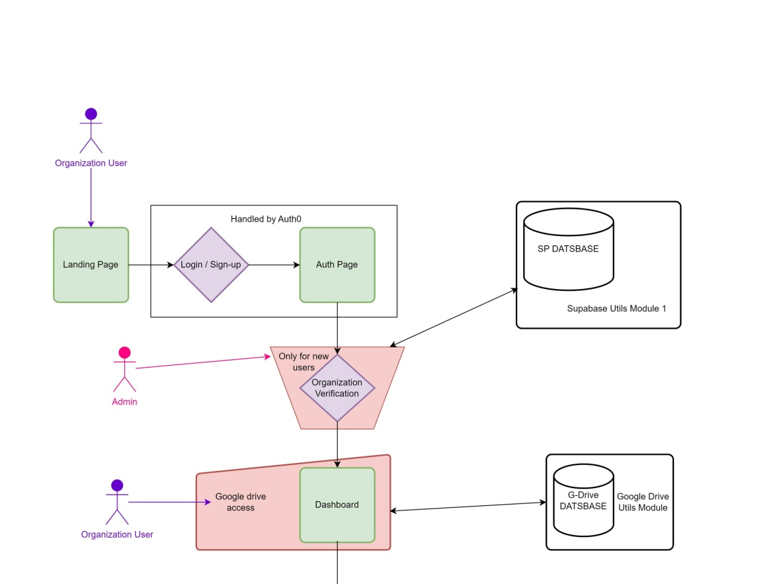
Login or Signup

Slide 9
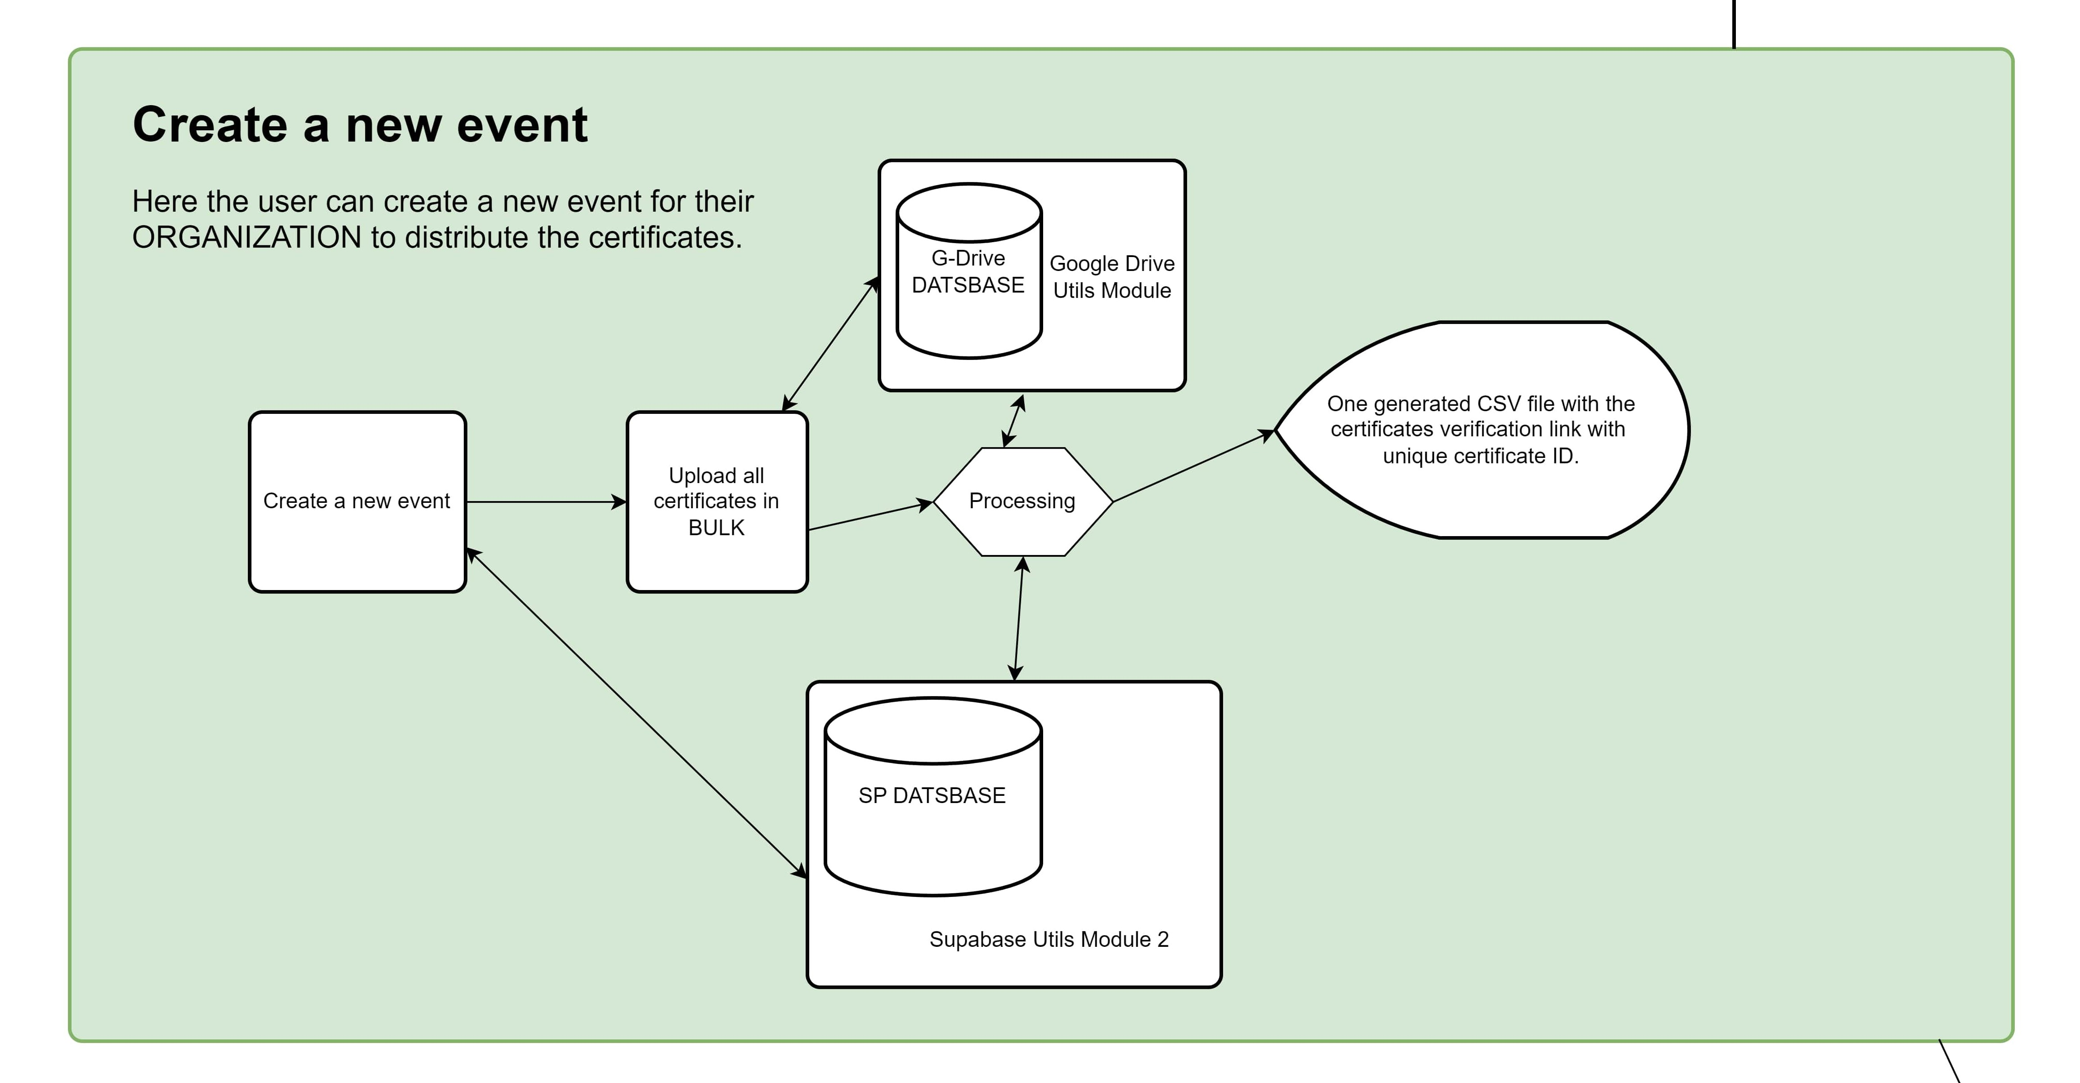
Create Events

Slide 10
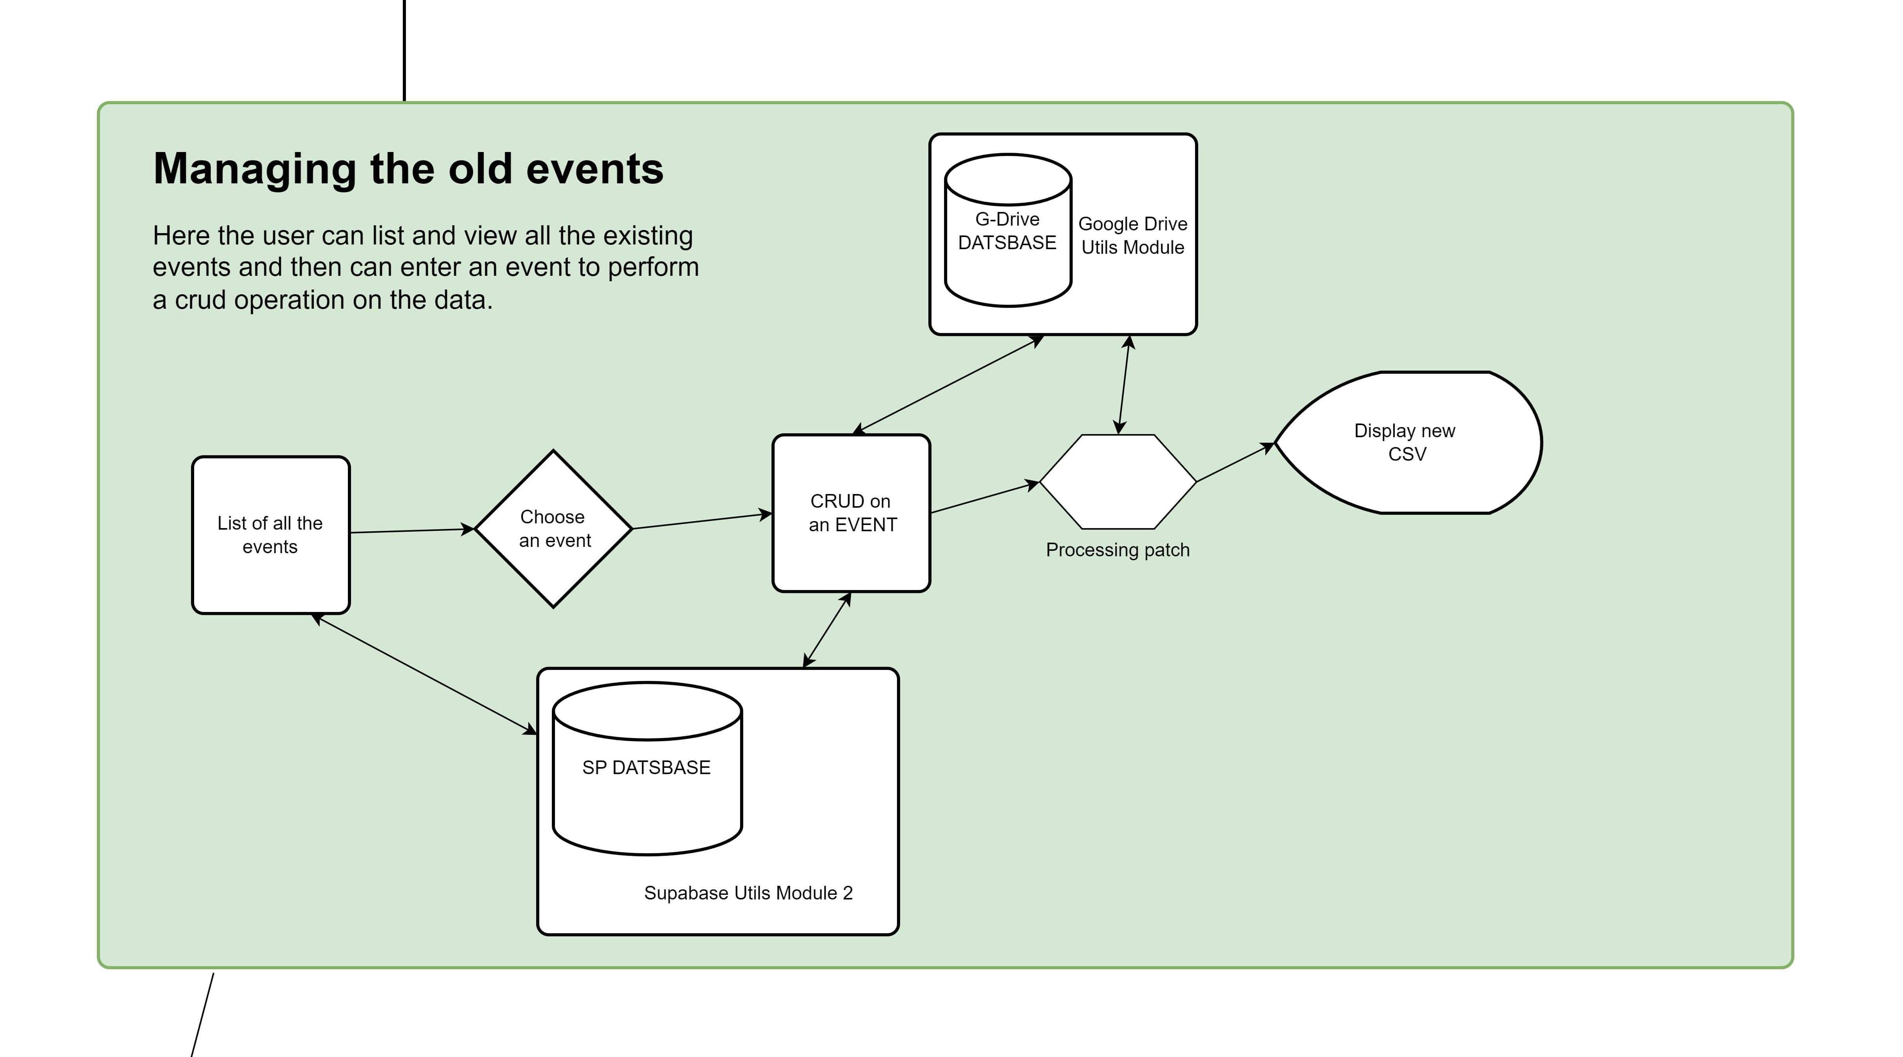
Manage Events

Slide 11
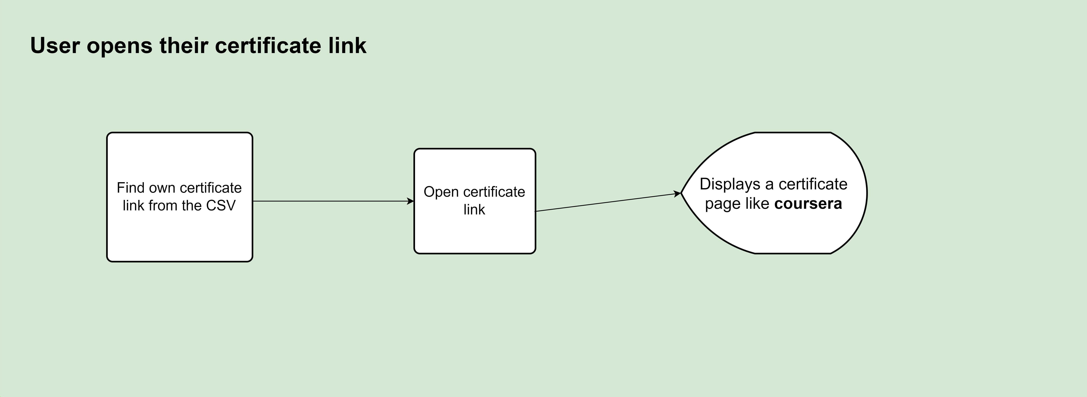
Certificate Distribution and Retrieval
Organizers generate CSV files with student names, roll numbers, and certificate links.
Students securely retrieve certificates using unique links.
Streamlined distribution process ensures authenticity.

Slide 12

Future Scopes
Implement a dedicated student login for certificate search.
Enhance event management features, including advanced tracking and cancellation options.
Continuously improve user experience and expand system capabilities.

Slide 13

Benefits and Outcomes
Unique certificates prevent forgery and enhance credibility.
Verified organizers ensure event legitimacy.
Improved certificate distribution and event management streamline processes.
Potential to revolutionize event management for organizers and attendees.

Slide 14
Conclusion
The UNICEVER project achieves its objectives by delivering a secure, efficient, and innovative event management solution.
Unique features, advanced security, and streamlined processes promise a significant impact on the event organization landscape.

